Slide 1

To change the image:
Right click on the slide
Click “Format background”
Choose your image (Size: 1400x1050px)
Webinar: the impact of COVID-19.
Has a recovery already started?
Grzegorz Sielewicz
Economist Central & Eastern Europe Region
17th June 2020

Slide 2



Coface Webinar: the impact of COVID-19 on the economy
YOUR HOST
  Declan Daly
  CEO Central & Eastern Europe Region
  declan.daly@coface.com
  Grzegorz Sielewicz
  Economist Central & Eastern Europe Region
  grzegorz.sielewicz@coface.com
Questions?
  Please submit any questions in
  the Questions Panel.
  Your host will answer them at the end of the presentation.

Slide 3
Lockdowns are being eased very gradually
Stringency index (source: Oxford University)

Slide 4
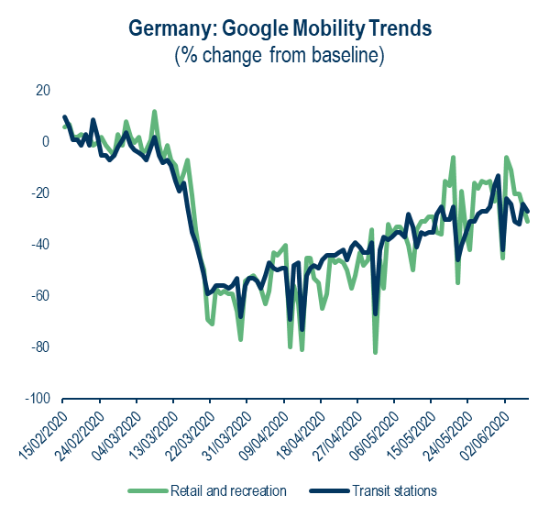
High frequency indicators: a very gradual recovery is now underway
Source: Google
Source: Google

Slide 5
Lockdown: a massive shock in Q2, but all sectors are not all in the same basket
Estimated shocks on net debt and turnover by sector in Q2 2020
(listed companies, sources: Coface and Thomson Reuters)

Slide 6
Beyond Q2, differentiated recoveries
Forecast of COVID-19 impact on selected global sector sales compared to a scenario without COVID-19 (turnover of listed companies)

Slide 7
World economic growth in 2020: lower than in 2009
World GDP growth
(Coface’s forecast, %)
Coface’s GDP growth forecasts
(%)

Slide 8
German industries: The pressure is strong
ifo business climate in single sectors
(in points)
Ifo survey May: How many months does it take
to normalise the business situation?
(average and range in months)
Source: ifo, Datastream, Coface
Source: ifo, Coface

Slide 9
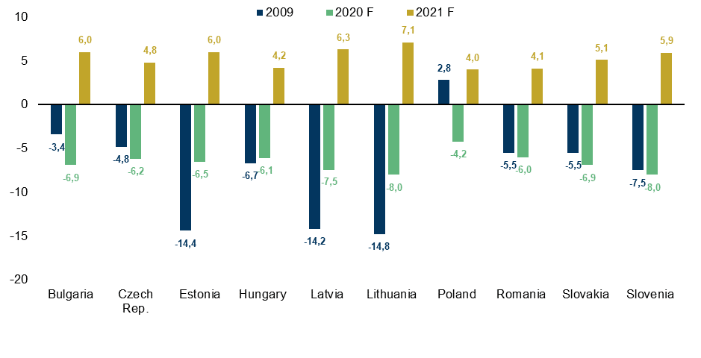
One of The deepest recession in CEE since transformation
GDP growth
(%, 2009 data and latest Coface forecasts for 2020 and 2021)
Source: Eurostat, Coface

Slide 10
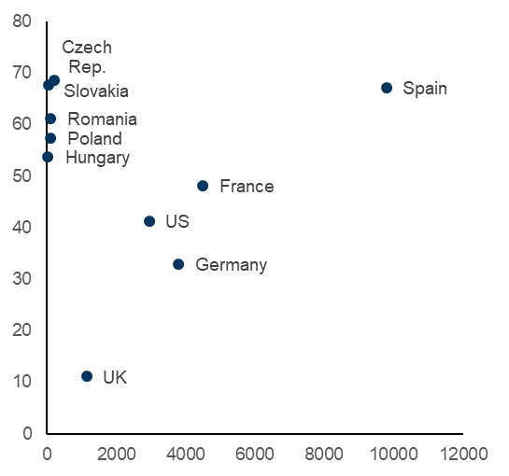
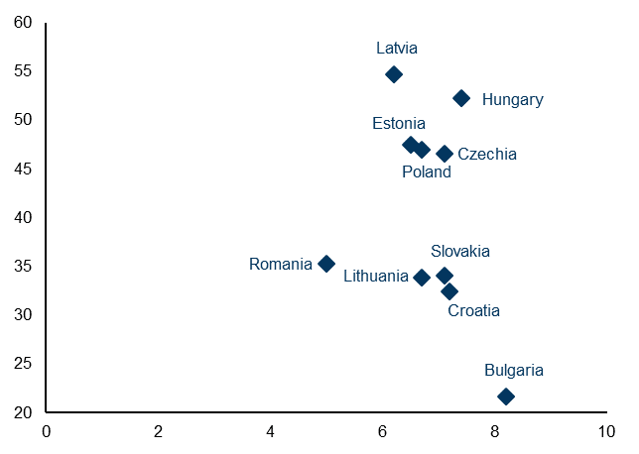
CEE: Promptly introduced restrictions
Stringency index and a number of Covid-19 cases
(as reported on 15th March 2020)
Health indicators: healthcare spending
and health security index
Stringency index
Health security: response capability
Healthcare spending (% of GDP)
Number of confirmed Covid-19 cases
Source: Oxford University
Source: World Bank, GHS Index, wiiw

Slide 11
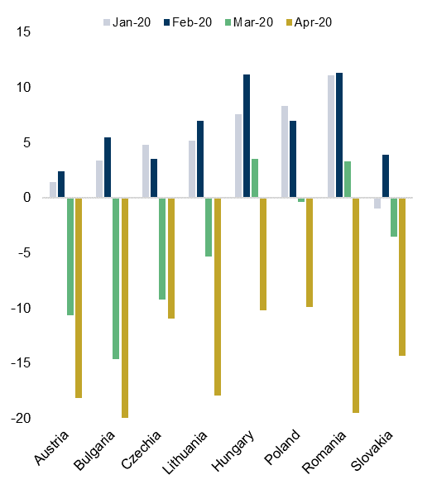
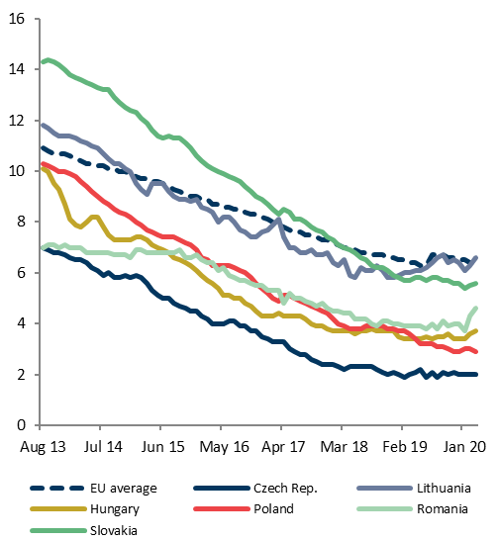
Is it the End of cee growth driven by household consumption?
Retail sales
(%, YoY changes)
Unemployment rates
(%)
Source: Eurostat
Source: Eurostat

Slide 12
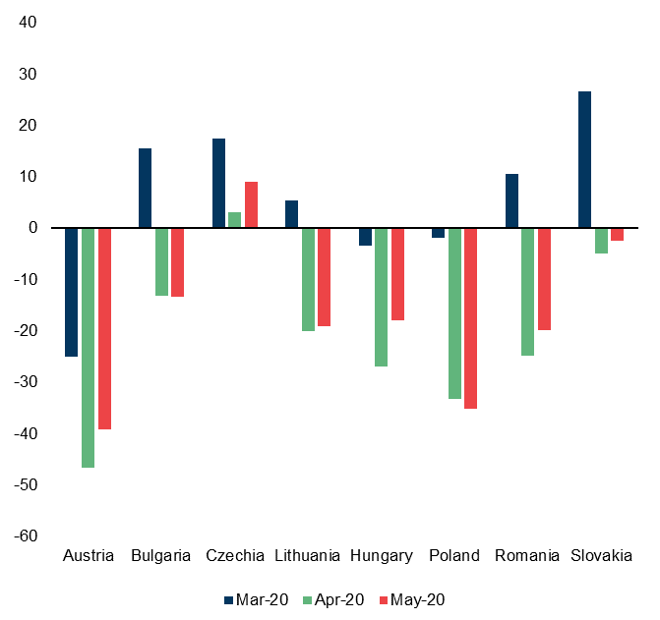
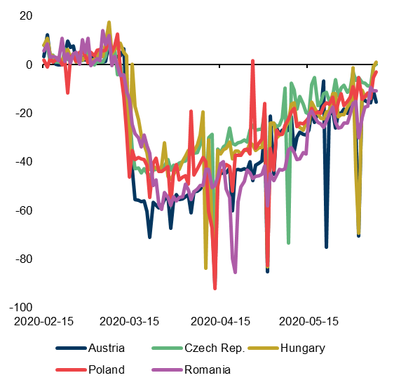
slow and gradual rebound has started
Retail confidence indicator
Google mobility data
(%, change versus baseline)
Source: Eurostat
Source: Google

Slide 13
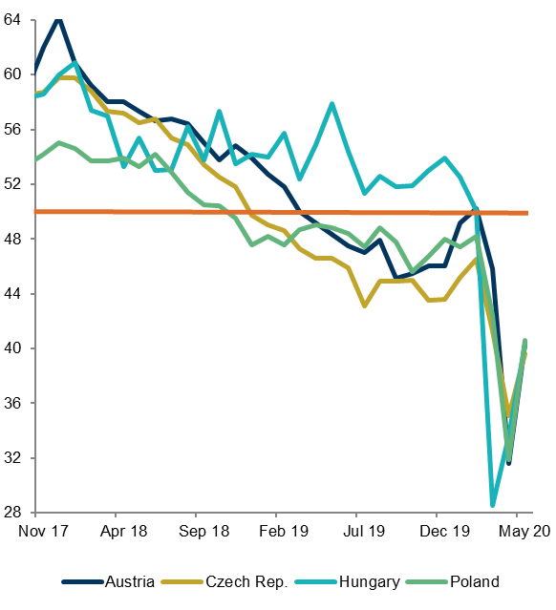
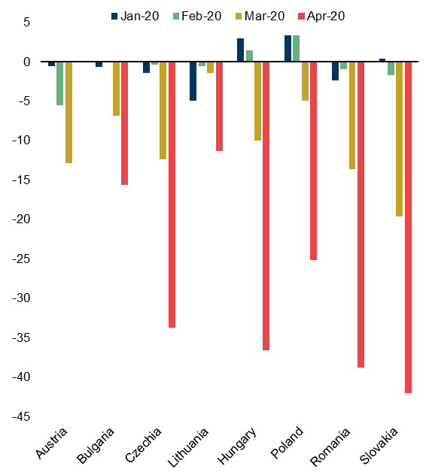
Contracted demand and lockdown took a toll on manufacturing
PMI Manufacturing
Industrial production
(%, YoY changes)
Source: Markit, HALPIM, UniCredit
Source: Eurostat

Slide 14
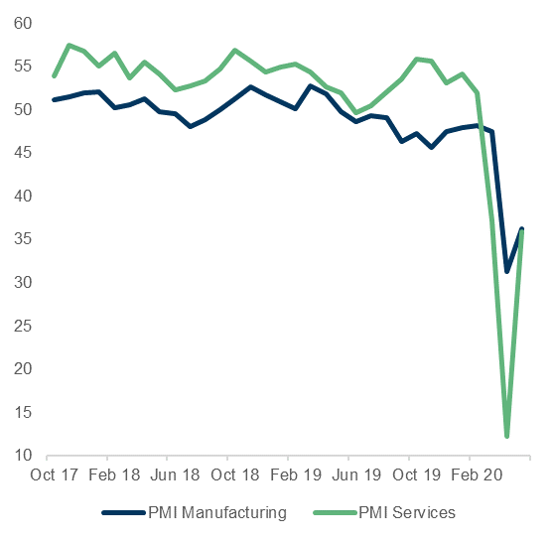
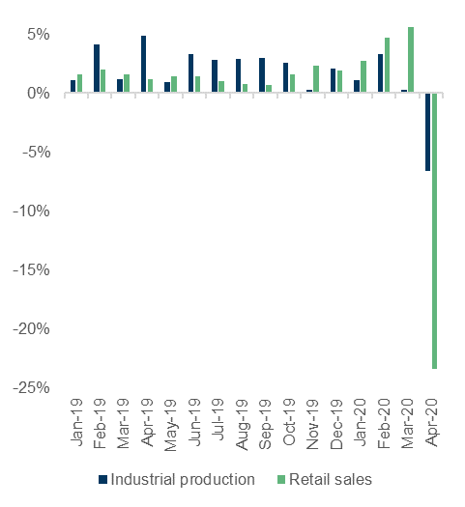
Russia: The covid-19 impact comes with a delay
Russia: Purchasing Managers’ Index (PMI)
Russia: Industrial production and retail sales
(YoY changes)
Source: Markit
Source: Rosstat

Slide 15
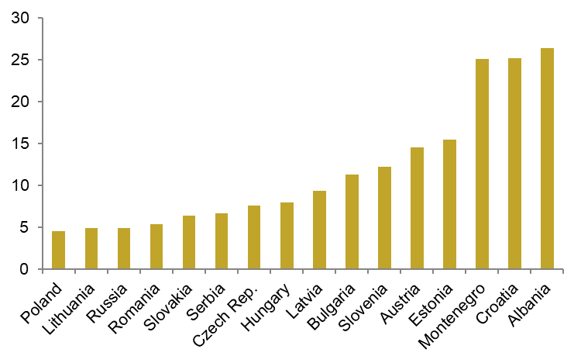
Weak perspectives for Tourism
Tourism is an important part of Balkan economies
Tourism in CEE countries
(% of GDP, 2018)
Source: World Bank

Slide 16
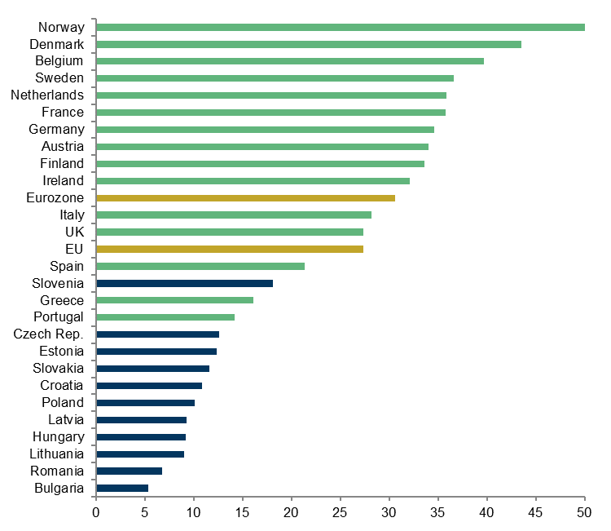
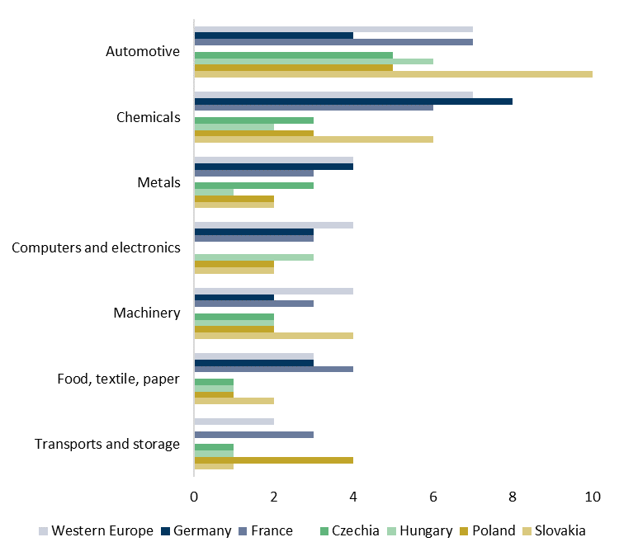
CEE Labour costs remain attractive amid an increase of productivity
Labour costs
(EUR/h, 2018)
Automation: Use of service robots in selected sectors
(%, percentage of enterprises, 2018)
Source: Eurostat
Source: Eurostat

Slide 17
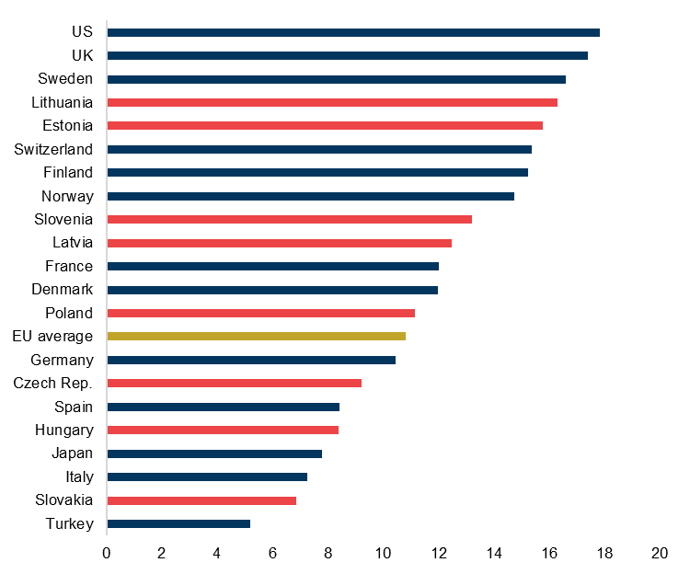
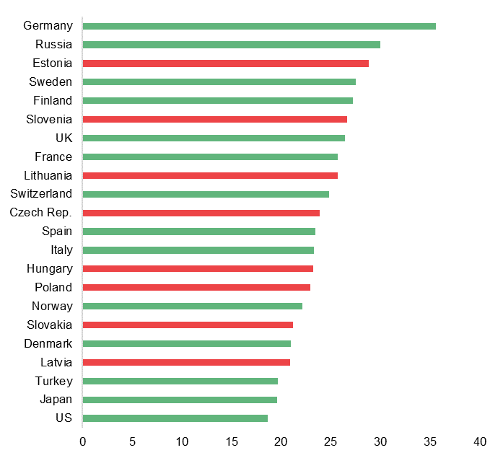
Digitalisation will attract an inflow of services outsourcing to CEE
ICT task-intensive jobs as a share
of total employment (%)
New tertiary graduates in science, technology, engineering
and mathematics as a share of total new graduates (%)
Source: OECD Going Digital Toolkit
Source: OECD Going Digital Toolkit

Slide 18
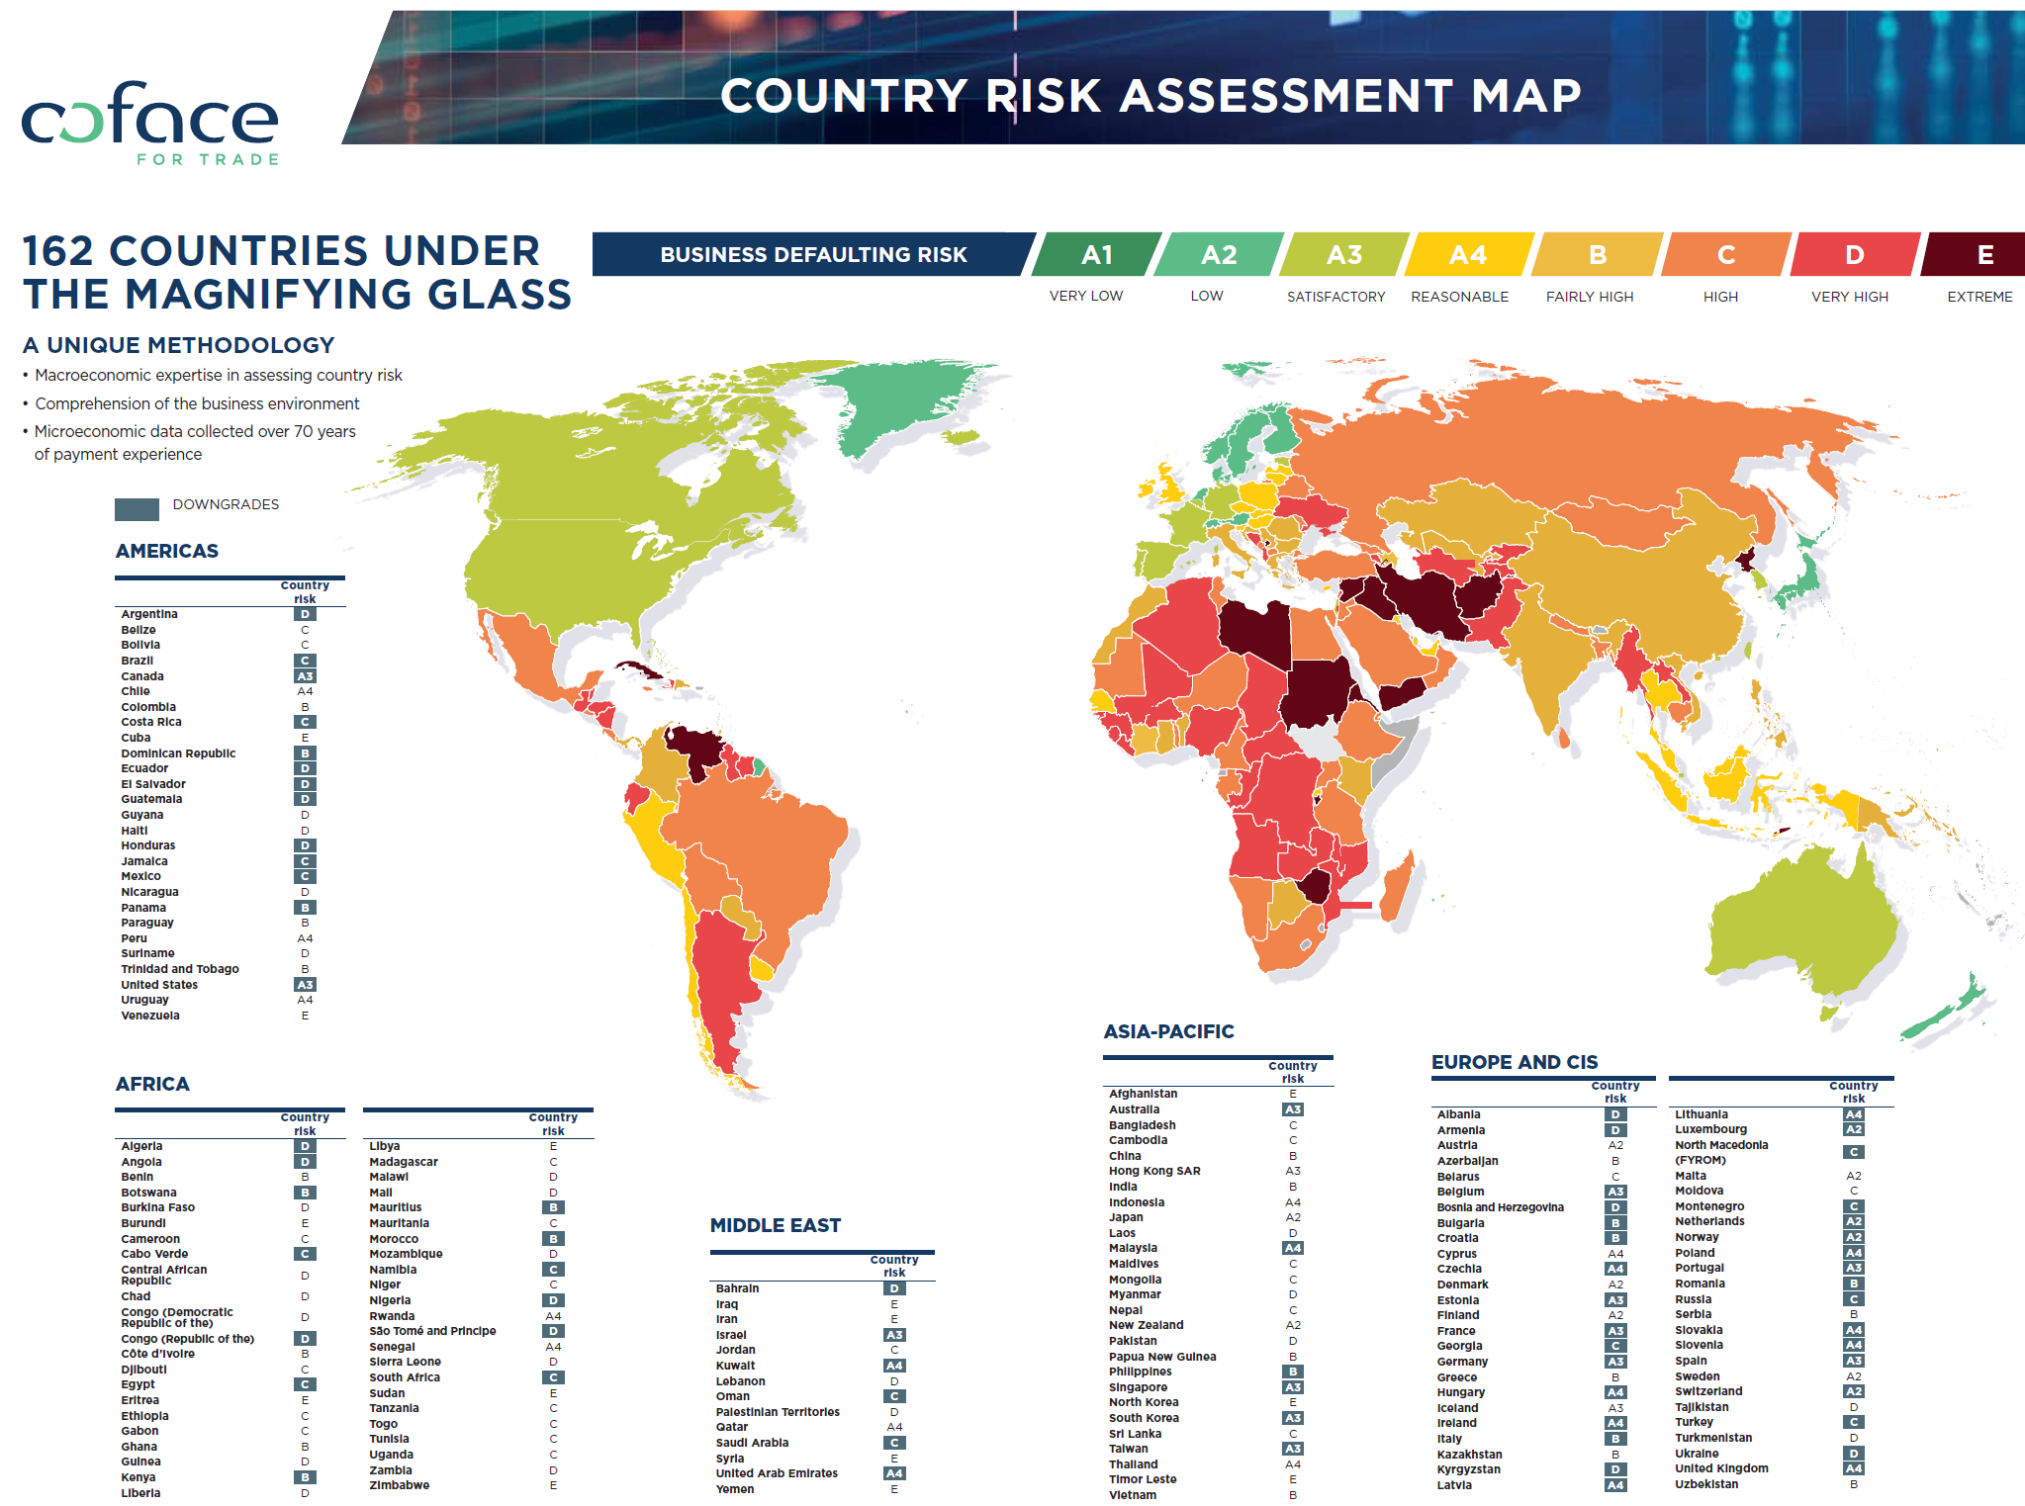

Slide 19
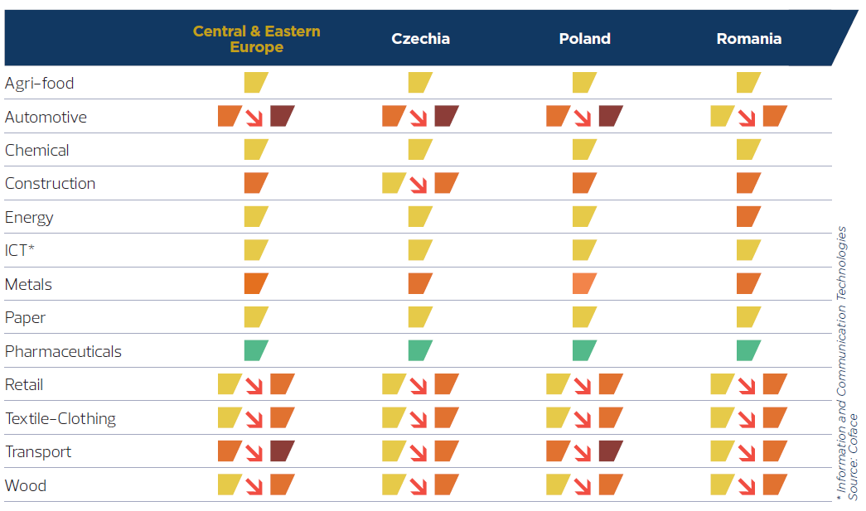
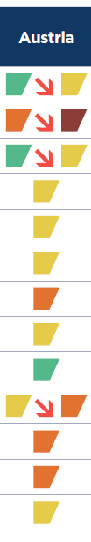
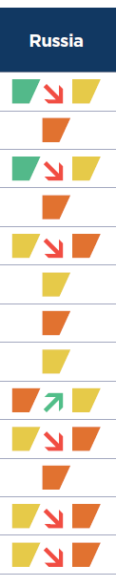

Coface Sector risk assessments

Slide 20

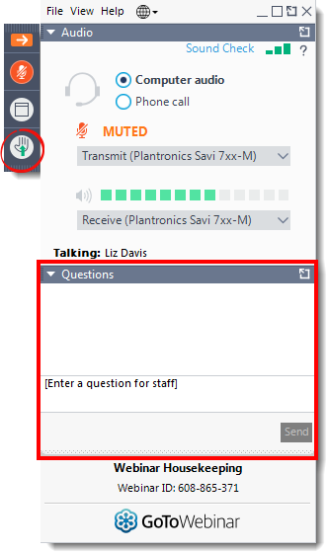
To change the image:
Right click on the slide
Click “Format background”
Choose your image
(Size: 1920x1080px)
Q&A Session
Any questions?
Please submit your text questions and comments using the Questions panel.
Note: Today’s presentation is being recorded and will be provided within the next few days.

